Slide 1
Mini Project
Karl-Oskar Janzon
Kristian Katt
Alvaro Lacave

Slide 2

The result of the models:
Random Forest performed best with the lowest RMSE (725.84) and MAE (415.06), and the highest R² Score (0.9643), indicating it made the most accurate predictions while maintaining generalization.
XGBoost underperformed compared to Random Forest, with a higher RMSE (1170.40) and MAE (795.86), likely due to the need for further hyperparameter tuning and sensitivity to noisy data
The Stacking Model (Combination of Both) improved over XGBoost but did not outperform Random Forest, achieving an RMSE of 827.91 and MAE of 518.89, showing that while ensemble learning helped, Random Forest alone provided the most stable and accurate predictions.
After test it with the real Data we discovered some issues to generate the prediction and we can not trust the final prediction and compare it with the original file.

Slide 3
Methods (preprocessing)
Summary:
1. Change to numerical values.
2. Checking the correlation matrix to see any overlaps
3. Removed “unnamed” as it is likely an index column from the csv file.
4. Converted the “date” column to DateTime format, ensuring it is properly interpreted as a date.

Slide 4
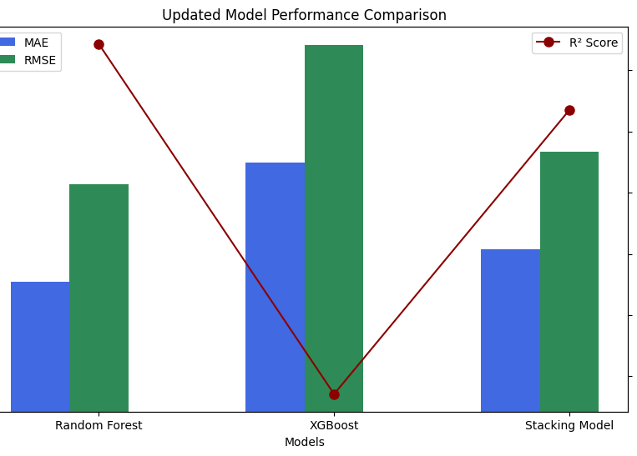
Comparative of the models:
Xgbboost performance:
RMSE: 1170.400953390326
MAE: 795.8567760367577
R² Score: 0.9071184396743774
Random Forest Performance:
MAE:
415.05873300200307
MSE:
526844.7849651902
R² Score: 0.9642774239309655
Stacking Model Performance: RMSE: 827.9090017668183
MAE: 518.8939933244393
R² Score: 0.9535243691472934

Slide 5
Method 1: Random Forest Performance
Captures Complex Relationships: handles non-linear interactions between variables .
Robust to Overfitting: reduces overfitting, ensuring reliable predictions even with noisy or fluctuating sales data.
Handles Missing Data and Outliers: resilient to missing values and outliers, allowing it to provide accurate predictions even in messy, real-world sales data.
Feature Importance: helping businesses understand what drives sales and optimize strategies.
Scalable and Versatile: It performs well with large datasets and works seamlessly with both numerical and categorical data.

Slide 6
Method 2: XGBoost
Handles Non-Linearity and Complex Patterns.
High Accuracy and Efficiency.
Robust to Overfitting.
Handles Missing Data Well.
Feature Importance and Interpretability.

Slide 7
Method 3: Stacking model performance
Combines Multiple Models for Better Accuracy.
Improved Generalization.
Handles Complex Data Relationships.
Increased Robustness.

Slide 8
Takeaways
We spent too much time changing parameters and models and try different models instead of polishing the models we had.
Had issues when saving and loading the models, in order to later use those to predict real_data sales.
Had issues with date, in the end real_data does not include date, which is problematic.
Our prediction is going to be very low unfortunately. ☹

Slide 9
Instructions
You can make the charts with python or excel.
All team members must participate (either split the slides, or discuss the part that you did for each slide)
7 minutes maximum for presentation + 3 minutes for questions
7 is a HARD limit. Aim for 5, it should be enough.
Tip: Rehearse the presentation at least once

Slide 10
Deliverables
Github repo → submit to Ironhack
Code
README.md
Presentation (ppt / pdf)
Predictions (G1.csv) ← REAL.csv + column with your sales predictions
Slack
R2 prediction for the REAL dataset

